Slide 1

Edge AI Traffic Intelligence System
CP 330: Edge AI [Jan 26]
Team members: Boddu Amarnath, Rohan Kumar Biswal, Utkarsh Vats
Github link: Project Repo

Slide 2
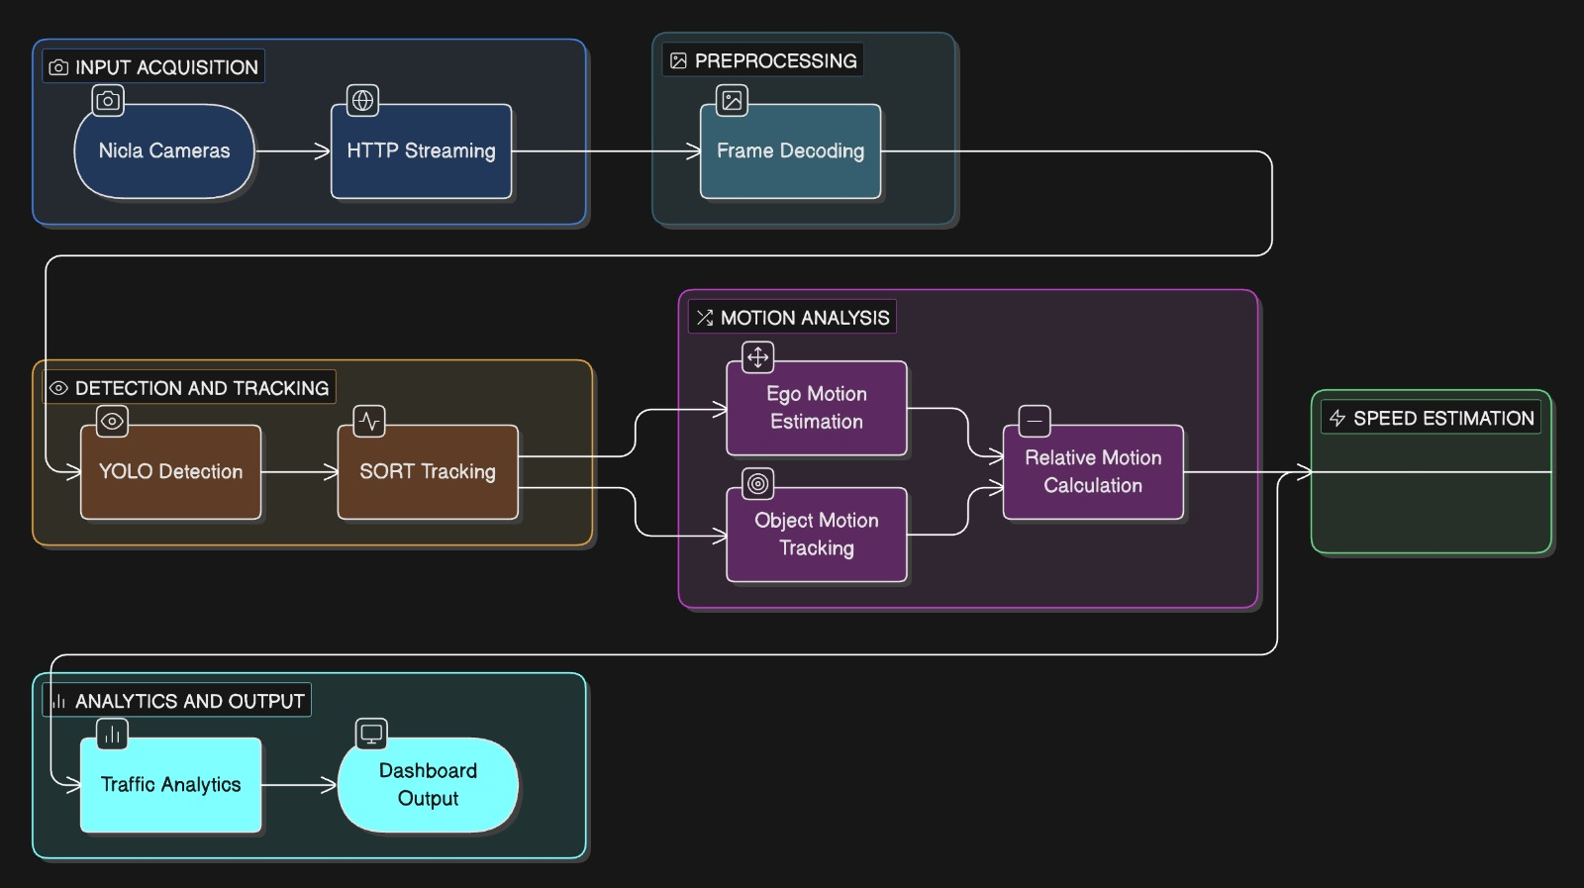
Flow Chart

Slide 3
Methods used
IMU to Velocity
Object Detection(YOLO) – model optimized through quantization and pruning
Kalman Filtering for Tracking
Data Association (Hungarian Algorithm)
Optical Flow for Ego Motion
Relative Speed Estimation
Congestion Detection
Speed Variance
Risk Score Model
Nicla Audio

Slide 4
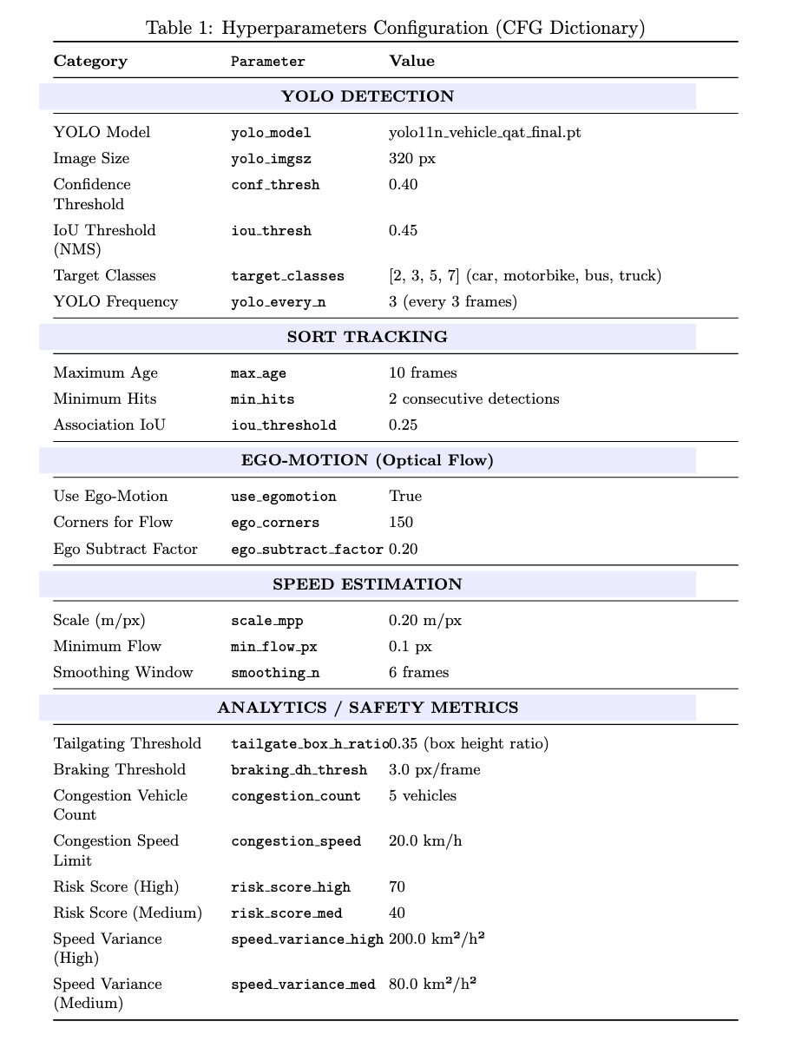
Hyper parameters

Slide 5
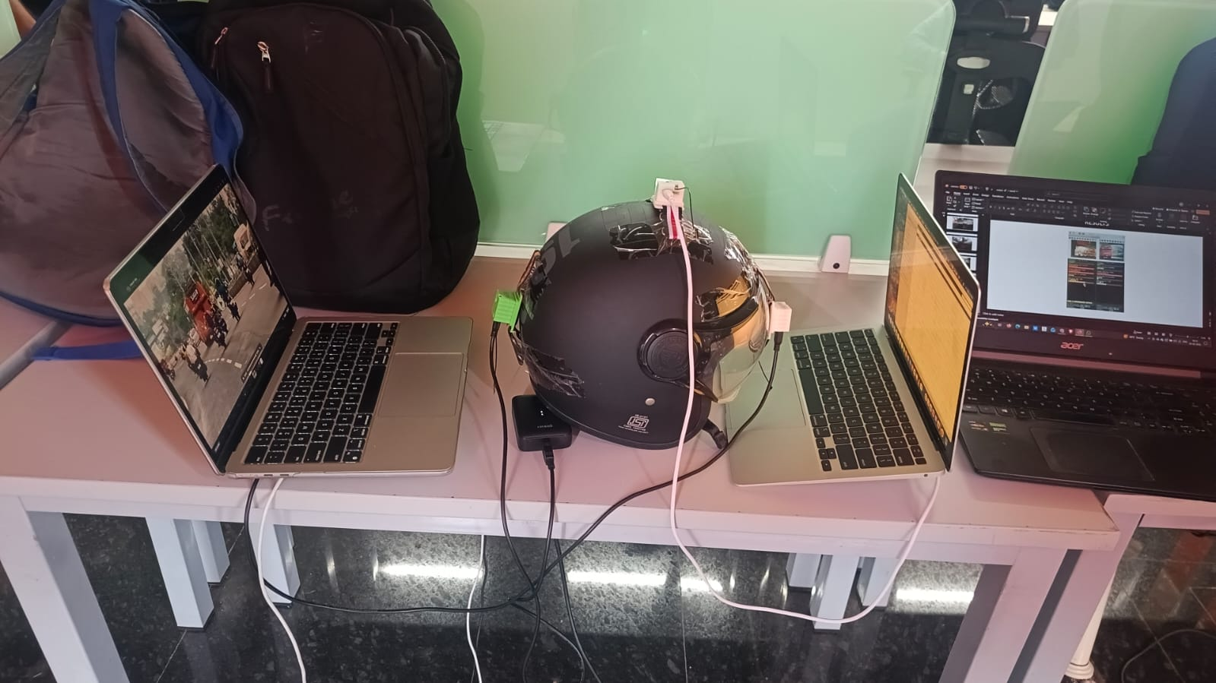
Demo model

Slide 6
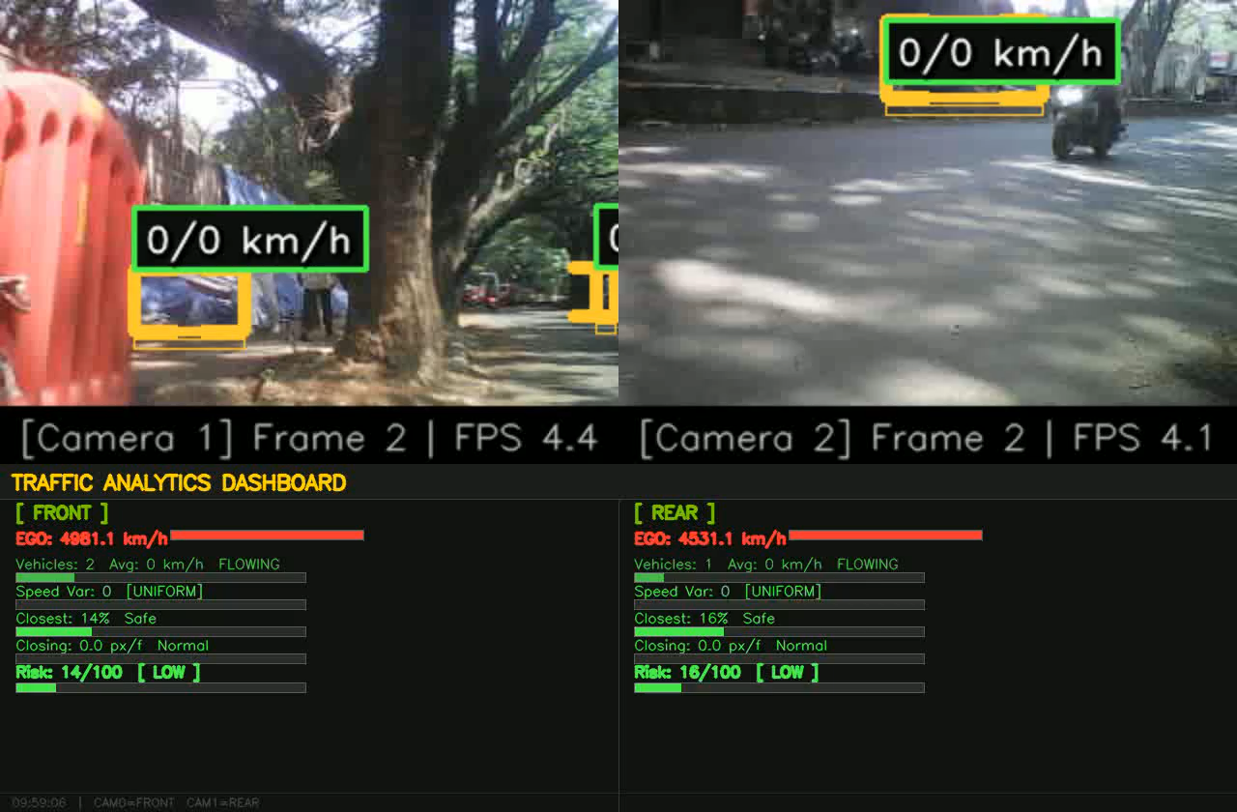
RESULTS

Slide 7
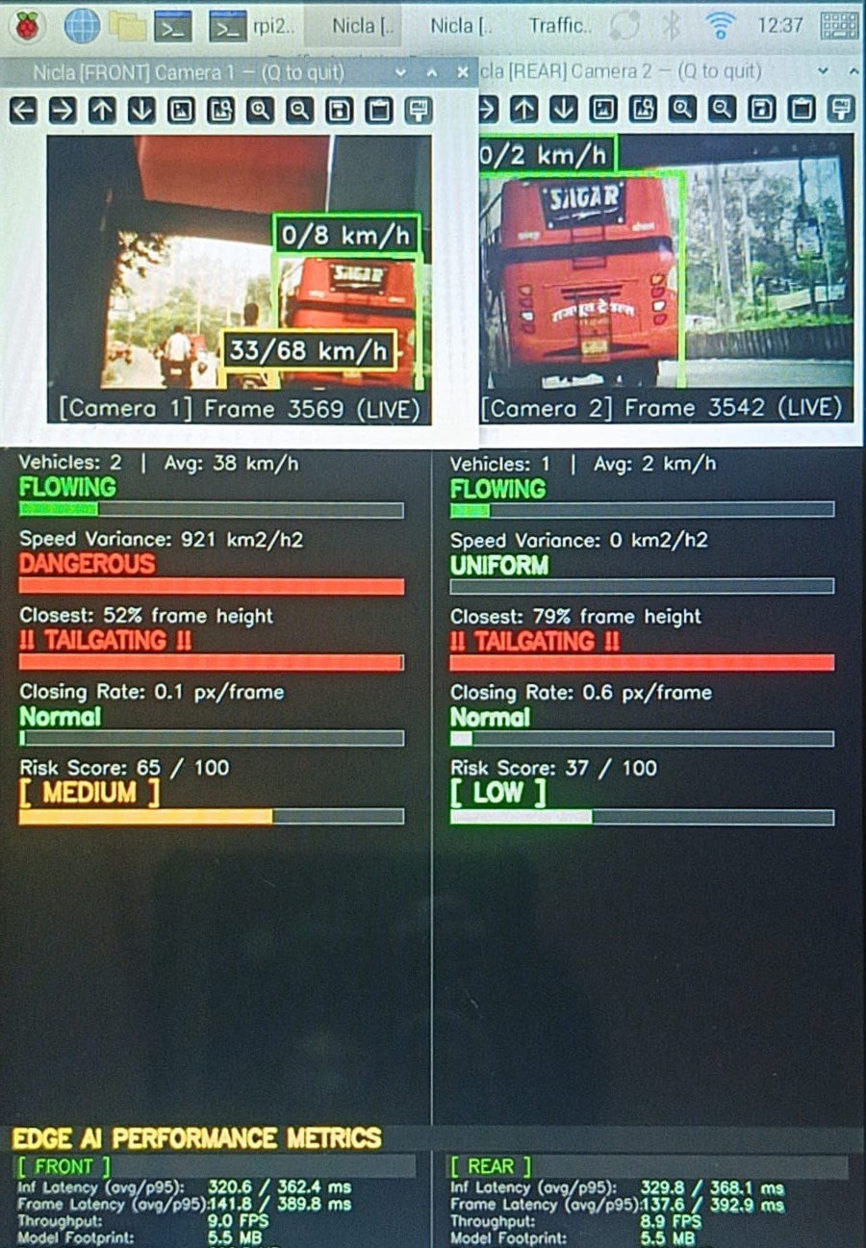
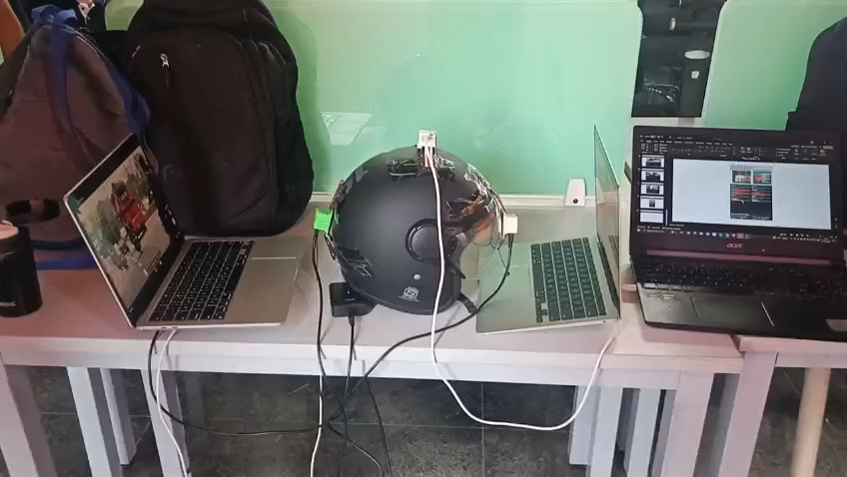
RESULTS

Slide 8
CONS
Drift — any small constant bias in the accelerometer multiplies over time. The 0.95 decay is the countermeasure here, but it also means the system can't track sustained constant-velocity motion perfectly (since at constant velocity, acceleration = 0, and the decay pulls speed toward zero).
No absolute reference — there's no GPS or wheel odometer to correct the estimate. The velocity is entirely relative and resets on reconnection.
Gravity contamination — if the device is tilted, gravity's component leaks into ax/ay. The dead zone partially masks this but doesn't fully eliminate it.
Connectivity issues

